Slide 1

Predicting Clinical Trial Success
Pharma AI Team:
Sheri Shojaie
Vivianti Santosa
Momotaz Mahin Khan
Eben Haezer Saputra

Slide 2
Clinical Trials are risky and expensive investment
Phase 3
$20M
Phase 2
$4M
86 %
Overall Failure Rate of drugs and vaccine trial
Phase 1
$4M
Clinical Trial Cost of drugs and vaccine trial
Notes:
Cost source: https://www.sofpromed.com/how-much-does-a-clinical-trial-cost/#:~:text=The%20average%20cost%20of%20phase,median%20of%20%2441%2C117%20per%20patient.
Failure rate: https://www.acsh.org/news/2020/06/11/clinical-trial-success-rates-phase-and-therapeutic-area-14845

Slide 3

This causes exorbitant medicine cost
Annual drug prescription can be $200,000 - $500,00
Increases cost of healthcare

Slide 4

But what if we…
…can predict which trial more likely to succeed?
… can find factors that affect clinical trial success rate?

Slide 5

Enter Machine Learning!

Slide 6
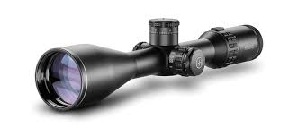
The process: 1. Scoping
Predicting success rate in Phase 2 only
Trials in United States only
Only features approved by Domain Knowledge Expert
Limited Text Parsing

Slide 7
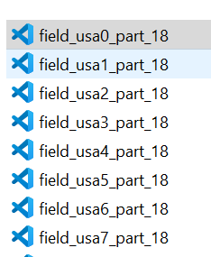
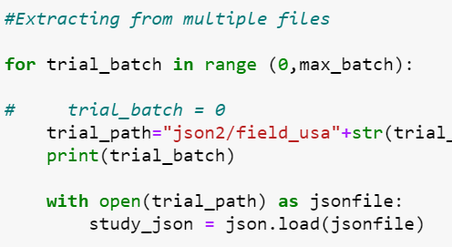
The process: 2. Data Extraction & Cleaning
API Extraction
Split to 18 batches
Auto Merging JSON
Out of 4GB of files

Slide 8



The process: 3. Data Storage
AWS RDS for Database, S3 for Storage

Slide 9
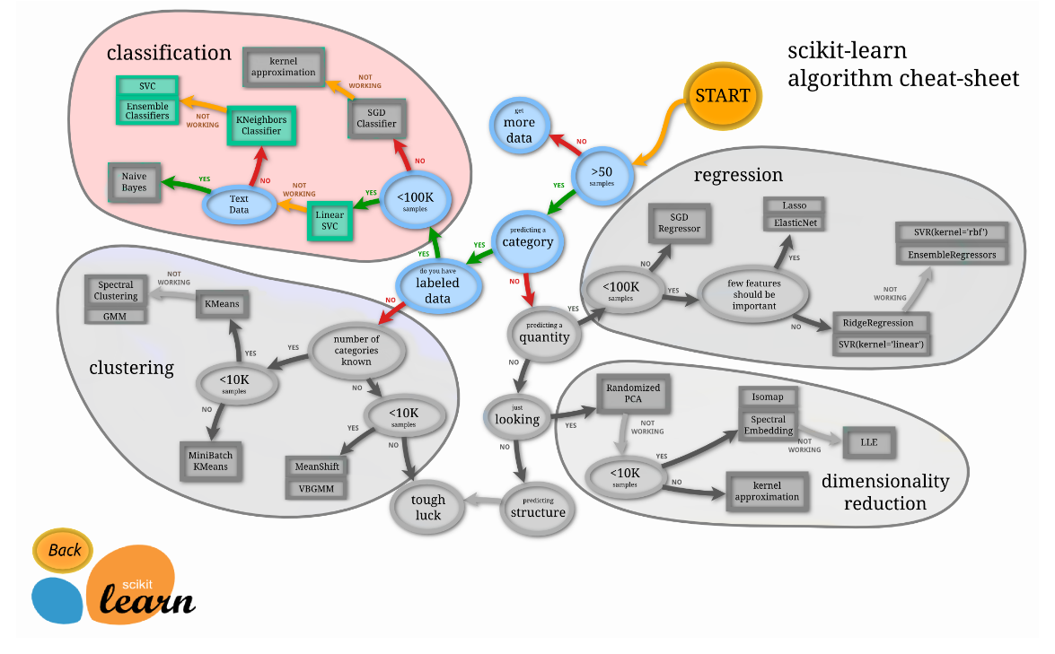
The process: 4. Sklearn for Machine Learning
Logistic Regression
K Nearest Neighbor
Random Forest

Slide 10
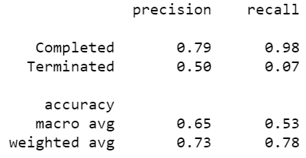
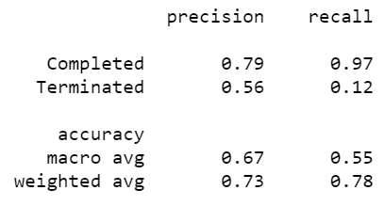
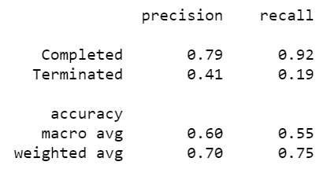

Result: The Calculation
Logistic Regression
Random Forest
K Nearest Neighbour

Slide 11
Result: Visualization
Click here for Tableau!

Slide 12
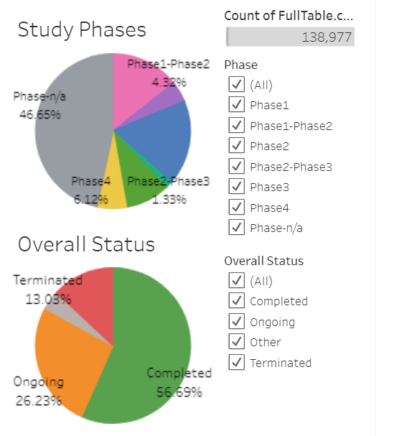
Visualization Result – part 1
Dashboard #1
Goal:
Give quick understanding of our data size
Show number of the data before, and after we apply filter
Show proportion of data (terminated, completed, etc)
Emphasize:
Number of Trials at current filter state (Count of FullTable)
Percentage of Overall Status
Everything else is not necessary at this point, I think?
Maybe use only small part of Dashboard3, but in bigger size

Slide 13
Visualization Result – part 2
Dashboard #2
Goal:
Show viz result of Random Forest, highlighting 6 chosen features
Allow user to navigate between different conditions, so they can compare
Thought:
Basically Dashboard4, but we use only data from Random Forest Prediction
Let’s make sure the middle part is not blank

